Slide 1

Pediatric Chain of Survival
1.prevention,
2.early CPR,
3.prompt access to the emergency response system,
4.rapid PALS,
5. integrated post– cardiac arrest care.
the first 3 links: BLS
افشین صفایی
دانشیار دانشگاه علوم پزشکی گیلان
Notes:
1- since injury is the leading cause of death in children over 1 year of age and motor vehicle crashes are the most common cause of fatal childhood injuries; targeted interventions, such as the use of child passenger safety seats, can reduce the risk of death.

Slide 2
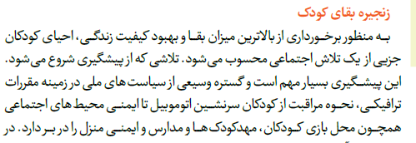

Slide 3
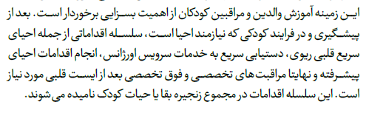

Slide 4
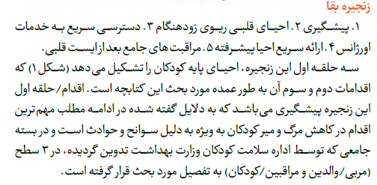

Slide 5

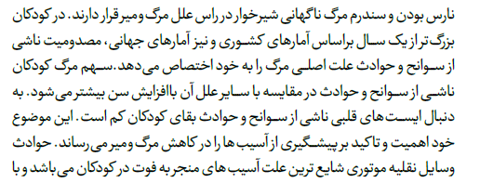

Slide 6
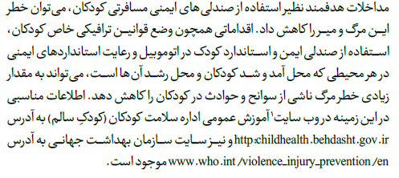

Slide 7
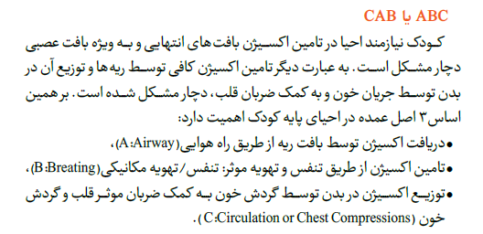

Slide 8
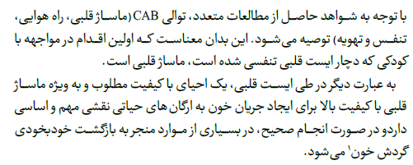

Slide 9
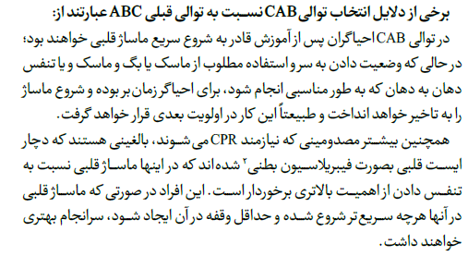

Slide 10
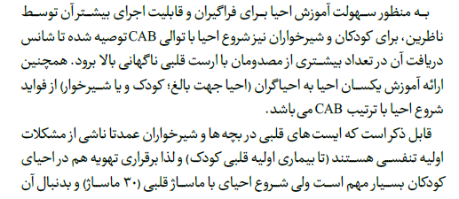

Slide 11
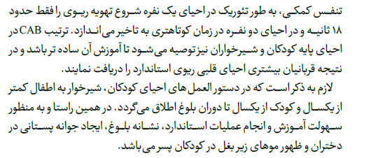

Slide 12
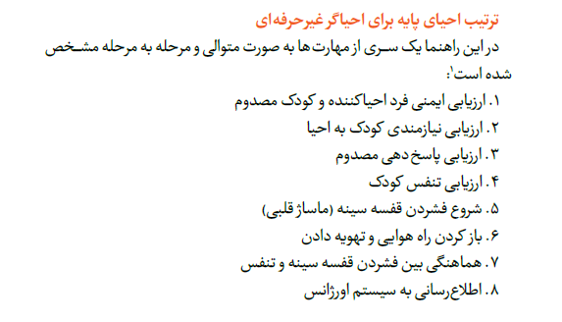

Slide 13
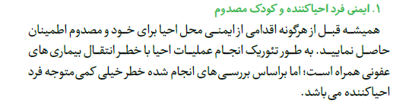

Slide 14
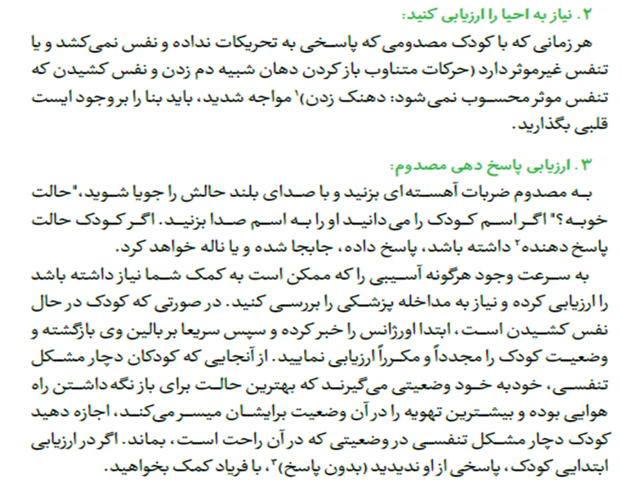

Slide 15
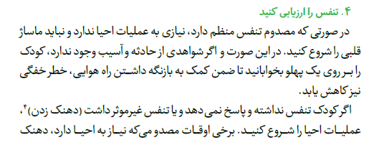

Slide 16
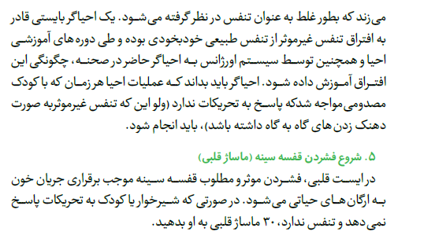

Slide 17
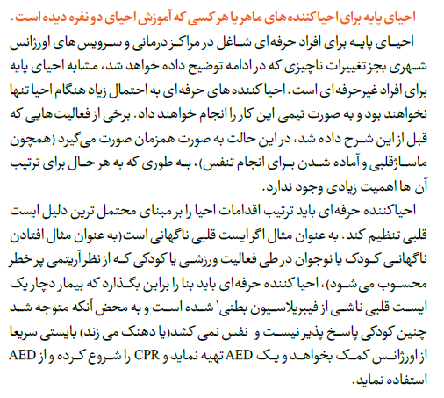

Slide 18
